Slide 1
How personal is our safeguarding? Somerset Annual Conference 2nd March 2023
Dr Adi Cooper OBE
Visiting Professor, University of Bedfordshire
Independent Chair City and Hackney Safeguarding Adults Board, Haringey Safeguarding Adults Board
Care and Health Improvement Adviser, Local Government Association (London region & safeguarding lead)
Non-Executive Director, Social Work England

Slide 2
Learning Objectives
Recap on what is Making Safeguarding Personal? – and how it is included in the Care Act 2014 guidance
Reflect on some challenges in Making Safeguarding Personal – ‘Myths and Realities’
Understand that Making Safeguarding Personal is a strength-based approach to safeguarding practice
Identify what would help to consistently and proactively make safeguarding personal / how do you know you are making safeguarding personal

Slide 3
Why Make Safeguarding Personal?
Questions that we (the sector) were asking ourselves:
Did anyone feel safer following safeguarding interventions?
Was protection planning effective?
Did people have a say in what was done to protect them?
Could we predict what people wanted that would protect them and make them feel safer?
Was safeguarding activity process dominated rather than personalised and outcome orientated?
Did we balance wellbeing and safety?
What good is it making somebody safer if it merely makes them miserable?’ (Munby, J, Local Authority X v MM & Anon (No 10 [2007])
Were people able to continue to maintain relationships that were important to them and keep themselves safe?

Slide 4
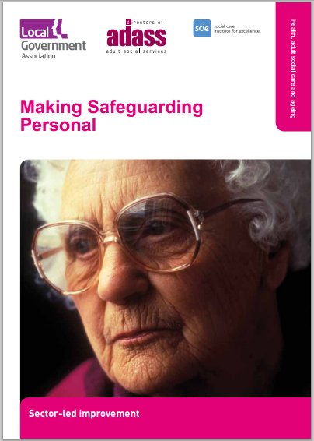
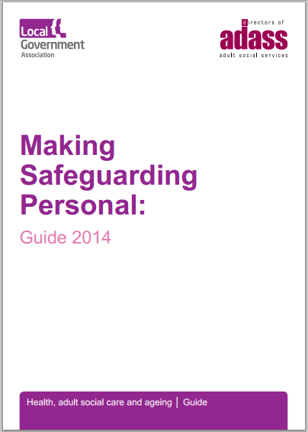
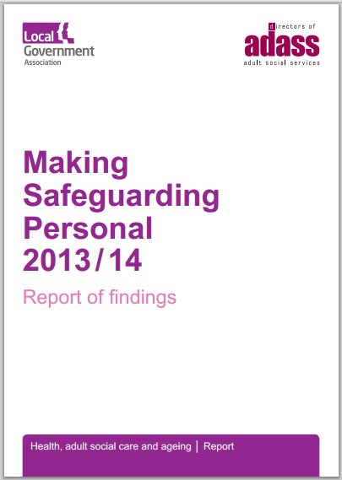
What is Making Safeguarding Personal (MSP)?
Making Safeguarding Personal means adult safeguarding:
is person-led
is outcome-focused
enhances involvement, choice and control
improves quality of life, wellbeing and safety
= change in culture and practice or ‘approach’ to safeguarding adults
(and meets Care Act Guidance)

Slide 5
What is safeguarding? – key message for Making SafeguardingPersonal
“people and organisations working together to prevent and stop both the risks and experience of abuse or neglect, while at the same time making sure that the adult’s wellbeing is promoted including, where appropriate, having regard to their views, wishes, feelings and beliefs in deciding on any action. Adults sometimes have complex interpersonal relationships and may be ambivalent, unclear or unrealistic about their personal circumstances.”
(Care and Support Statutory Guidance issued under the Care Act 2014, para 14.7)

Slide 6
What is Making Safeguarding Personal about?
Enabling safeguarding to be done with, not done to, people
Shifting from a process supported by conversations to a series of conversations supported by a process, enabling people to talk about what is important to them
Placing the person at the centre, ensuring their wishes (outcomes) are discussed and agreed with them at the start and throughout
Talking with people about their options and what they want to do about their situation ( ask ‘What do you want to achieve? And how?’)
Enabling people to resolve their circumstances, recover from abuse or neglect and achieve the outcomes that matter to them in their life (‘What do you want to be different? And how? )
Ensuring an emphasis on what would improve quality of life as well as safety - achieving meaningful improvement (Recording desired outcomes, ask: how effectively these have been met? how helpful have responses been?)

Slide 7
Making Safeguarding Personal practice is also about:
Utilising professional skills rather than ‘putting people through a process’ / utilising professional curiosity to understand the circumstances of someone’s life
Developing legal literacy to understand what legal options might be appropriate to use to support someone to keep themselves safe from abuse or neglect
Competent practice in applying the Mental Capacity Act 2005
Supporting ‘unwise’ decisions and enabling risk appropriately to someone’s personal circumstances
Upholding Human Rights
Working within a supportive organisational culture with strategic and management leadership that supports the Making Safeguarding Personal practice
Everyone sharing the Making Safeguarding Personal approach to safeguarding practice

Slide 8
6 Safeguarding Principles in the Care Act

Slide 9
Care Act 2014 safeguarding duties and responsibilities
To make enquiries, or cause them to be made, into circumstances of abuse (Section 42)
Set up a Safeguarding Adults Board (Section 43)
Arrange, a Safeguarding Adult Review, in certain circumstances (Section 44)
To share information
Duty to co-operate - in order to protect adults experiencing or at risk of abuse or neglect.
Provide advocacy for people during safeguarding work
Adopt the Making Safeguarding Personal approach

Slide 10
SAFEGUARDING and safeguarding
There are many risk and harms and there is a spectrum of safety/safeguarding issues
Concerns about safety and safeguarding are always concerning
Prevention and early intervention is better than escalation and harm
Statutory duties apply when someone has care and support needs, is experiencing or at risk of abuse or neglect and as a result of their needs is unable to protect themselves

Slide 11
Safeguarding duties
The Section 42 duty requires consideration of the following criteria:
Section 42 (1)
Whether there is “reasonable cause to suspect” that an adult:
i. has needs for care and support
ii. is experiencing, or is at risk abuse or neglect, and
iii. as a result of their needs is unable to protect themselves
Section 42 (2)
iv. Making (or causing to be made) whatever enquiries are necessary
v. Deciding whether action is necessary and if so what and by whom

Slide 12
Aims of safeguarding (Care Act 2014)
Stop abuse and neglect where possible
Prevent harm and reduce the risk of abuse and neglect
Safeguard adults in a way that supports them in making choices and having control about how they want to live
Concentrate on improving the life of the adult concerned
Raise public awareness so that communities play a role alongside professionals
Provide accessible information and support about how to stay safe and how to raise a concern
Address the causes of abuse and neglect

Slide 13
Making Safeguarding Personal in the Care Act 2014 guidance
People have complex lives and being safe is only one of the things they want for themselves. Professionals should work with the adult to establish what being safe means to them and how that can be best achieved (s.14.8).
The adult should be involved at the beginning of the enquiry, and their views and wishes ascertained (s.14.77, 14.78)
The wishes of an adult who lacks mental capacity ‘are of equal importance’ to someone with mental capacity (s.14.80)
Safeguarding plans involve joint discussion, decision making and planning with the adult for their future safety and wellbeing’ (s.14.90)
Safeguarding Adult Boards seek feedback from adults who have been involved in an enquiry (s.14.116)
Professionals and other staff should not be advocating “safety” measures that do not take account of individual well-being (s.14.8)

Slide 14
Making Safeguarding Personal- in brief
“What does the person want to happen?”
(”What outcomes do they want?”)
“Were they involved/ do they feel that they were involved?”
“Was what they wanted to happen (the outcome) achieved?
“What did they think of what happened?”
“Are they safer?”
“Do they feel safer?”

Slide 15
Questions

Slide 16
Table Exercise
How do you find out what someone wants to happen when they are confused, have fluctuating mental capacity, to make an informed decision about a risk in their life?
Discuss on your table for 5 minutes

Slide 17
‘Myths and realities about Making Safeguarding Personal’ 2019 LGA/ADASS

Slide 18
Making Safeguarding Personal Myths and Realities
Myths: ‘Walking away when people say ‘no’’
You can’t do MSP when a person refuses help and there is no obvious way in
Realities: use professional curiosity and relationship-based practice to understand why. Explain all options. You can override someone’s wishes if the person lack capacity to decide, there are issues regarding duties of care, public interest, or if a criminal offense has or may have been committed, if an adult at risk is being affected, if a child is being affected and/or risks to others to be considered.
There are powers to carry out assessments under the Care Act 2014 …

Slide 19
Ascertaining the views and wishes of the adult
Making Safeguarding personal does not mean walking away if a person declines support. Consider….
Care Act, 2014, Section 11. Refusal of assessment
(1) Where an adult refuses a needs assessment, the local authority concerned is not required to carry out the assessment (and section 9(1) does not apply in the adult's case).
(2) But the local authority may not rely on subsection (1) (and so must carry out a needs assessment) if —
(a) the adult lacks capacity to refuse the assessment and the authority is satisfied that carrying out the assessment would be in the adult's best interests, or
(b)the adult is experiencing, or is at risk of, abuse or neglect.

Slide 20
Making Safeguarding Personal Myths and Realities
Myth: 'Making Safeguarding Personal is just a chat over a ‘cuppa’
Reality: MSP is about culture and practice change, using all your skills to help people keep themselves safe, resolve issues, address risks, recover from distress and trauma, in ways that work for them.
Myth: 'If you do MSP and don’t bring perpetrators to justice because the person doesn’t want action, they will go on and abuse again.'
Reality: We use our legal literacy, responsibilities for duties of care and public interest to ensure that people causing harm don’t abuse others, even when some may advocate non-action. And we explain what and why.

Slide 21
Making Safeguarding Personal Myths and Realities
Myth: 'Doing MSP takes too much time – staff don’t have time to explain what safeguarding is…..it's just not realistic'
Reality: Adopting this approach requires conversations with people and may take longer in the shorter term but will be more effective in the longer term, e.g. protection planning that works and achieves the persons outcomes, safety and well-being
Myth: 'It’s not possible to use an MSP approach where/when people lack mental capacity'
Reality: We can use advocates and people who know the person to understand what outcomes they would have wanted to be safe, as in any other area of decision making.

Slide 22
Questions

Slide 23
Strengths Based Approaches (Slide courtesy of Lyn Romeo – Chief SW for Adults)
Local Area Coordination
Strengths Based Approaches
ASSET BASED COMMUNITY DEVELOPMENT (ABCD)
Systemic Social Work
Person Centred Approaches
Narrative Approaches
Signs Of Safety
Signs Of Safety
Appreciative Inquiry
Restorative Practice
Family Group Conferencing
Making Safeguarding Personal
3 conversations model
Solution Focused
C.B.T

Slide 24
What are strength – based approaches to practice?
“People are often doing amazingly well, the best they can at the time, given the diﬃculties they face and the known resources available to them.
People have survived to this point certainly, not without pain but with ideas, will, hopes, skills, and other people, all of which we need to understand and appreciate in order to help.
Change can only happen when you collaborate with clients’ aspirations, perceptions, and strengths and when you ﬁrmly believe in them.” Saleeby 1992.p.42,
Cited by Lyn Romeo, Chief Social Worker for Adults, Department of Health (2017) Strength based social work practice with adults, Department of Health

Slide 25
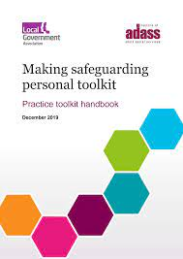
MSP and strength-based practice
Making Safeguarding Personal as a strength-based approach to safeguarding practice
When we work with someone we find out about their resilience and strengths as well as their needs and the risks in their lives.
Delivering Making Safeguarding Personal can be done using different tools and models
https://www.local.gov.uk/msp-toolkit (Research in Practice)

Slide 26
Tools and models that can support the Making Safeguarding Personal approach
Restorative Approaches : based on restorative justice methods, It is about building, maintaining and restoring relationships between people, families and communities. It is often used in schools and youth justice with an aim to ‘repair harm’. Underpinning principle is that work is done ‘with’ people, rather than ‘for’ or ‘to’ them.
Family Group Conferencing : A process led by family members to plan and make decisions. Originally from New Zealand, it is characterised by having an independent neutral person who prepares people for the meeting and helps them think about the decisions that need to be made and by information sharing followed by private family time where the family come up with the plan. (see frg.org.uk )
Appreciative Enquiry : Uses positive and future focused discourses to explore and develop narratives about ‘what works.’ Used in business/organisational development and in Signs of Safety approaches

Slide 27
Generic Strengths Based Approaches that can support Making Safeguarding Personal
3 Conversations Model : Conversation 1. How can I connect you to things that will help you get on with your life – based on your assets, strengths and those of your family and neighbourhood. What do you want to do? Conversation 2 Who is at risk? What needs to change to make you safe and regain control? How do I help to make that happen? What offers do I have at my disposal to support you in the ‘emergency plan’ and stay with you to make sure it works? Conversation 3 What is a fair personal budget? What does a good life look like? How can I help you to use your resources to support your chosen life? Who do you want to be involved in good support planning?
Narrative Approaches (White and Epstein 1990) : language used to tell ‘stories’ of peoples lives and problems is significant. This approach seeks to deconstruct and separate the problem from the person so that ‘the problem’ and the person’s relationship with it can be worked on and new narratives can be created.
Person Centred Approaches : People have vast resources for self-understanding, for altering self-concepts, attitudes and self-directed behaviour - which can be tapped. Change happens within relationships characterised by empathy, understanding, acceptance (having unconditional positive regard) and is genuine and congruent.

Slide 28
Community Strengths Based Approaches that support Making Safeguarding Personal
Focus on prevention and community capacity building
Asset Based Community Development : Based on the premise that communities have the assets and resources to meet their own needs and focuses on mapping and building links between the individuals, associations and institutions to mobilise these ‘micro assets’ for the benefit of the ‘macro environment’ https://www.neighborhoodtransformation.net/pdfs/What_%20is_Asset_Based_Community_Development.pdf
Local Area Co-ordination : Co-ordinators are linked to a particular district and get to know the local area and services, enabling them to build connections and signpost people to services and facilities that they want to help them. Principles include; no eligibility criteria; whole family approach; commissioned or statutory services as a final consideration
http://lacnetwork.org/local-area-coordination/what-is-local-area-coordination/
See MSP Toolkit : https://www.local.gov.uk/msp-toolkit

Slide 29
Making Safeguarding Personal – reflection and discussion on tables
How can I ensure that MSP is embedded in practice?
How do I know the MSP approach is being consistently applied?
What would help me know that I was making safeguarding personal?

Slide 30
Making Safeguarding Personal voluntary data return safeguarding enquiries 2021/2022
Majority (over 80% of Local Authorities) provided returns to NHS Digital on asking people about their outcomes for a safeguarding enquiry
92, 655 people or their representatives were asked what their desired outcomes were – for each safeguarding enquiry
81% of those asked expressed their desired outcomes
Of these, 67% of outcomes were fully achieved; 28% were partially achieved and 5% not achieved

Slide 31
Resources
Making Safeguarding Personal resources
https://www.local.gov.uk/our-support/our-improvement-offer/care-and-health-improvement/making-safeguarding-personal
MSP Case Studies (2019), https://www.local.gov.uk/sites/default/files/documents/25.143%20Making%20Safeguarding%20Personal_04%20WEB_0.pdf
MSP Toolkit (2019) https://www.local.gov.uk/msp-toolkit or https://www.local.gov.uk/sites/default/files/documents/MSP%20Toolkit%20Handbook%20-%20FINAL%20December%202019%20v1.1.pdf
Myths and realities about MSP (2019) https://www.local.gov.uk/sites/default/files/documents/25.144%20MSP%20Myths_04%20WEB.pdf
Making decisions on the duty to carry out enquiries (2019)
https://www.local.gov.uk/making-decisions-duty-carry-out-safeguarding-adults-enquiries and https://www.adass.org.uk/media/7326/adass-advice-note.pdf
MSP podcasts (2019) accessed via https://soundcloud.com/rip-ripfa/sets/busting-myths-that-surround-making-safeguarding-personal/s-4nukW

Slide 32
Useful Links
Department of Health (2021) Statutory guidance to support local authorities implement the Care Act 2014 Updated June 2020, London, HMSO
https://www.gov.uk/government/publications/care-act-statutory-guidance/care-and-support-statutory-guidance
Cooper A. and White E. (2017) Safeguarding Adults Under the Care Act 2014: Understanding Good Practice, Jessica Kingsley Publications
Jane Lawson (2019) Community Care on Values ttps://www.communitycare.co.uk/2019/11/29/leaders-must-put-values-practice-make-safeguarding-personal/
Department of Health (2017) Strength based social work practice with adults, a roundtable report, Department of Health London https://www.gov.uk/government/uploads/system/uploads/attachment_data/file/631017/Strengths-based-social-work-practice-with-adults.pdf
Briefing on Working with Risk for Safeguarding Adults Boards https://www.local.gov.uk/our-support/our-improvement-offer/care-and-health-improvement/making-safeguarding-personal/working-risk
Social Care Institute of Excellence (SCIE) https://www.scie.org.uk/strengths-based-approaches and
https://www.scie.org.uk/safeguarding/adults

